Slide 1
UNDERGRADUATE ACADEMIC ADVISING AT
Undergraduate Academic Advising
September 2015

Slide 2
WHY IS ADVISING IMPORTANT?
Advising is a shared partnership
As an advisee you will be responsible for making sure
you know where to find the information you need to make important academic decisions.
you know the policies that effect you such as the suspension and probation policy and requirements for your major.
you have met your requirements for graduation.
Your advisor will help you to navigate all of this information and to assist you with developing your academic, career and personal goals.
Undergraduate Academic Advising
Notes:
Advising in College will differ greatly from High school. How so?
YOU are responsible for information and requirements you will need for graduation, not your advisor.
YOU are responsible to know how policies and procedures at RU affect YOU, such as the suspension and probation policies, which we will go over in this presentation.
It is important you become your own best advocate, ask questions and understand the policies and requirements that will effect you.
Your advisor will also be your advocate and guide to help you through the process.

Slide 3
IMPORTANT ADVISING RESOURCES
Undergraduate Academic Advising Website http://www.radford.edu/advising
Undergraduate Academic Advising
Notes:
The Undergraduate Academic Advising Website is all you need to know! It will have all of the information you need and will answer all of your questions.
If it does not, let your advisor know so it can be added to the website!

Slide 4
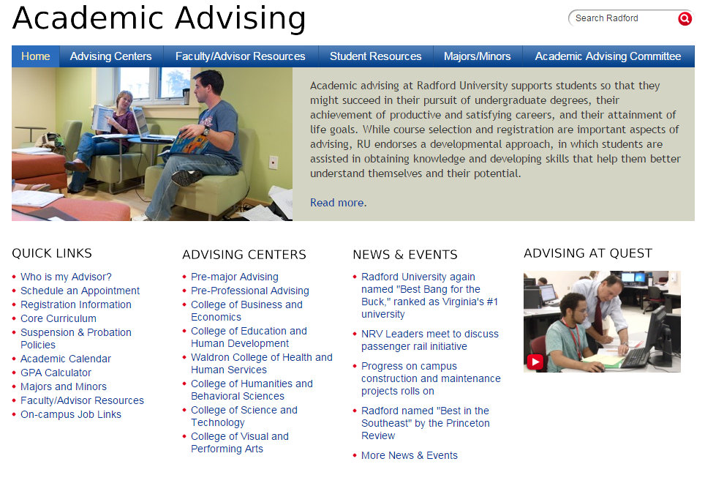
Undergraduate Academic Advising
Notes:
You can go to any one of the 6 college’s advising centers. The information about each center is on the website.
The College and Pre-major Advising Centers are generally open from 8 am – 5 pm and are a great resource to answer your questions.
Most of you will be advised by an advisor in your advising center
In addition there is important information you should look at:
Progress sheets for each major – which are your course requirements for the year you enter RU. The progress sheets are your most up-to-date, accurate resource for graduation requirements. But make sure you look at the progress sheet for the year you enter RU.
The Academic Calendar – to make sure you don’t miss important dates
The GPA Calculator
Information about Majors and Minors

Slide 5
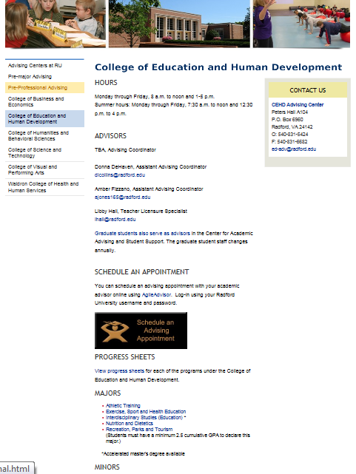
EXAMPLE OF ADVISING CENTER
Undergraduate Academic Advising
Notes:
The Advising centers have the
Locations
Hours
Progress sheets
Majors and even minors information

Slide 6
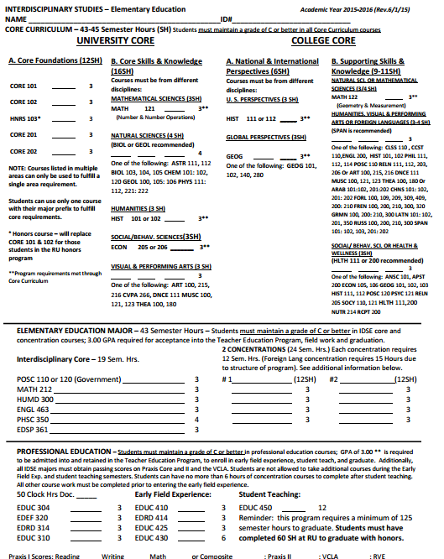
EXAMPLE OF PROGRESS SHEET
Undergraduate Academic Advising
Notes:
If you are in a major you should print off your progress sheet
Make sure it is for the year you entered Radford University
Print several copies!
Fill it in as you go
With the exception of the catalog for the year you entered, this is the most accurate record of the requirements, to include GPA requirements for your major. HOLD ON TO IT!

Slide 7
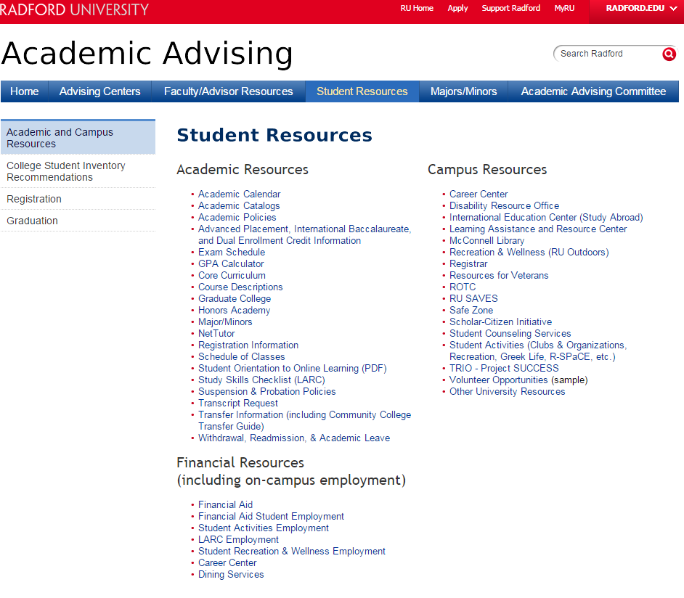
Undergraduate Academic Advising
Notes:
The Student Resource page on the Undergraduate Academic Advising Website has everything else you need to know such as
Course catalogs
Academic Policies and Procedures
Detailed Course Descriptions
On-line tutoring
Transfer information if you want to transfer a course in the summer back to RU
And important campus resources such as the Career Center, Registrar and Disability Resource Office

Slide 8
IMPORTANT DATES TO HIGHLIGHT
Sept. 4th. Last day for new students to add/drop courses through your advising center.
Sept. 14th. Last day to withdraw from the University with a full refund through your advising center.
October 13th. Majors and Minors Fair, Heth Hall, 1 – 3 pm.
Oct. 16th. Last day to withdraw from UNIV100 through your advising center.
Oct. 23rd. Last day to withdraw from an individual course(s) through your advising center.
November 20th. Last day to withdraw from the University with no grade penalty (no refunds) through your advising center.
November 21st-29th. Thanksgiving break.
December 14th-17th. Fall Exams.
Undergraduate Academic Advising
Notes:
Make sure you write some of the important dates on your calendar such as:
Majors and Minors fair
Last day to withdrawal from a class with a “W”
Final exams

Slide 9
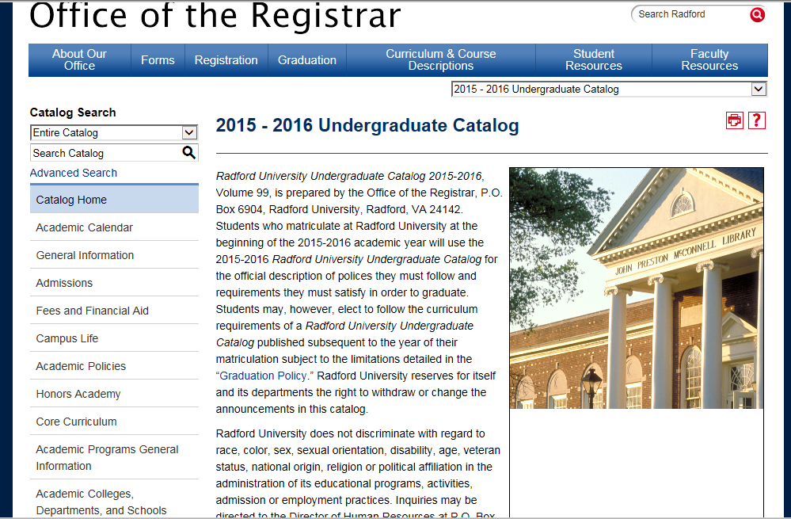
2015-2016 CATALOG
Undergraduate Academic Advising
Notes:
Did you know you have an undergraduate catalog for the year you entered Radford University? Why is the catalog important?
The catalog is your “contract” for requirements the year you entered Radford University
It has a list of the official Academic policies
It contains your Major and minor requirements

Slide 10
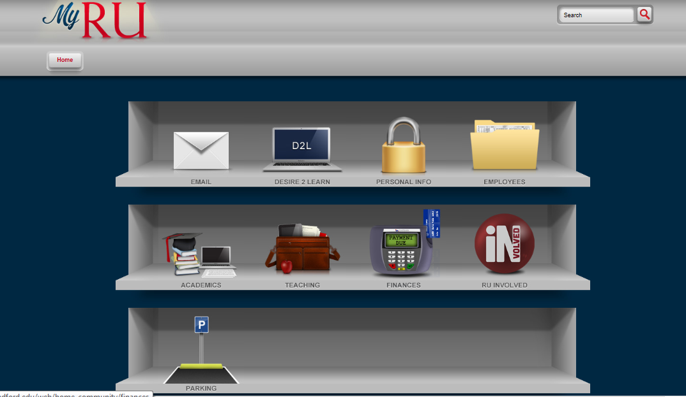
MyRU PORTAL
Check daily
Course Supplements
Schedule &
Degree Audit
Get involved
Undergraduate Academic Advising
Notes:
Your portal contains important information.
Check your Email daily. It is the University’s official communication.
Check out the get involved link
Let’s take a look at your Academics

Slide 11
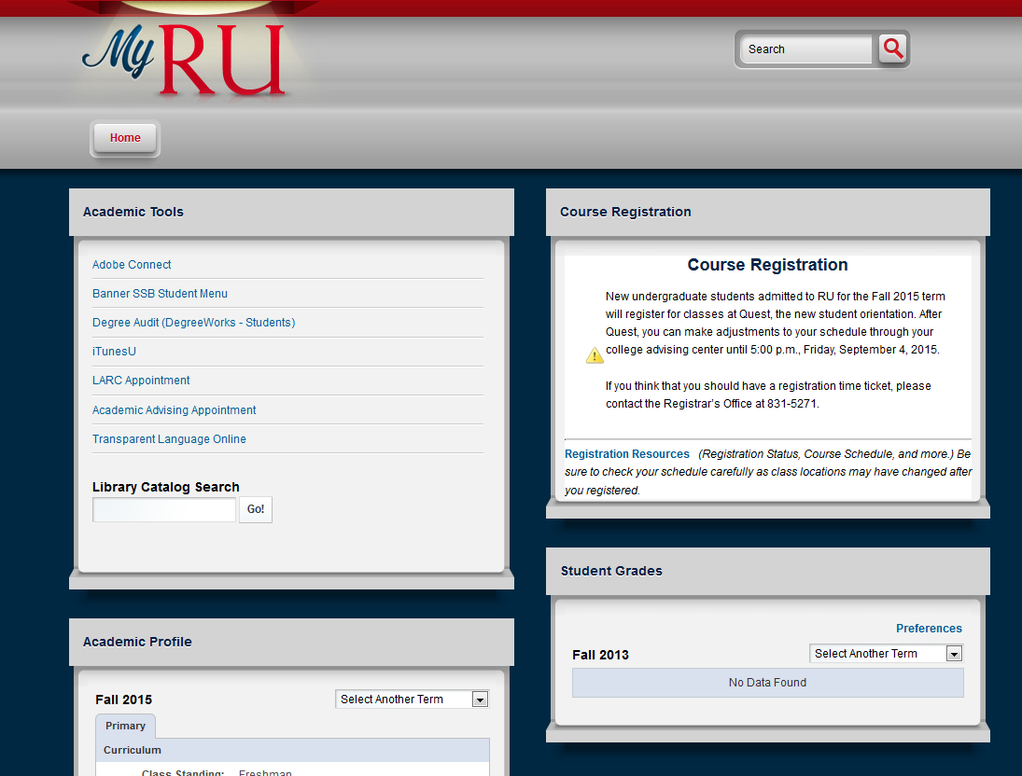
ACADEMIC TOOLS
Undergraduate Academic Advising
Notes:
Your Academic tools - Your Banner SSB Student Menu will be an important part of your advising.
Let’s look at what it has to offer.

Slide 12
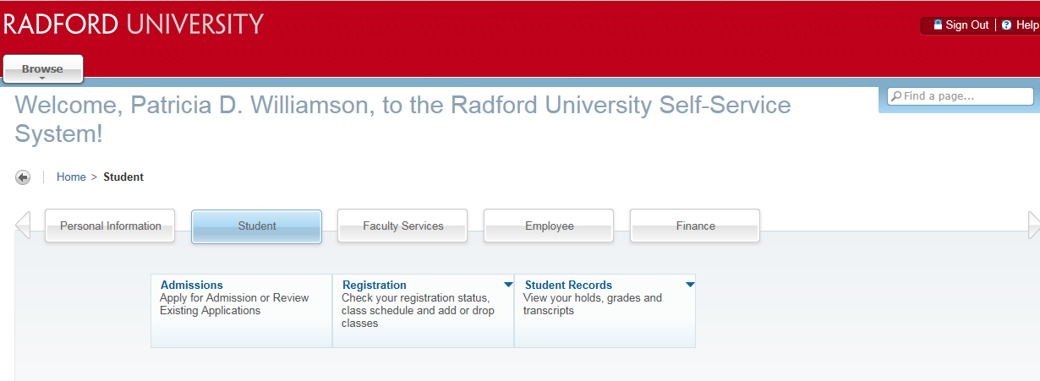
BANNER SSB STUDENT MENU
Undergraduate Academic Advising
Notes:
You can look at your personal information, student information, or finance information.
On the student information tab you can go to registration and look at your class schedule as well as open classes when it is time to register.
You can go to student records to make sure you do not have any holds preventing you from registering, check your grades and your unofficial transcript.

Slide 13
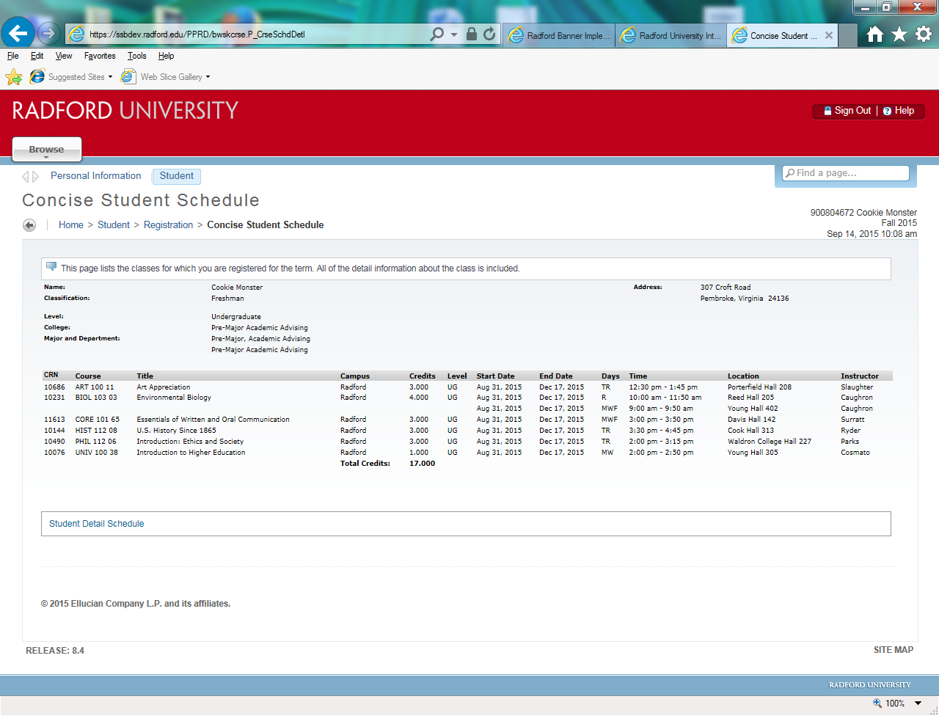
STUDENT SCHEDULE
Undergraduate Academic Advising
Notes:
It is never to late to check your schedule. Sometimes classes are canceled, dropped, or the location is changed and students may be attending a wrong class. Always check your schedule right before the semester begins.

Slide 14
DEGREE AUDIT
Undergraduate Academic Advising
Notes:
Back under your Academic Tools is your Degree Audit. Some advisors will ask you to print your degree audit and bring it to your advising appointment. You want to check your degree audit every semester.
Please know that the Degree Audit is NOT your official plan for graduation requirements. It can be wrong. Your Progress sheet (on the Undergraduate Advising Website) on the other hand is the most accurate information for your major requirements. Make sure you compare your Degree audit to your Major’s Progress sheet and ASK YOUR ADVISOR if something doesn’t match up or you have questions! Your advising center is always a great resource for Degree Audit and Progress sheet questions!

Slide 15
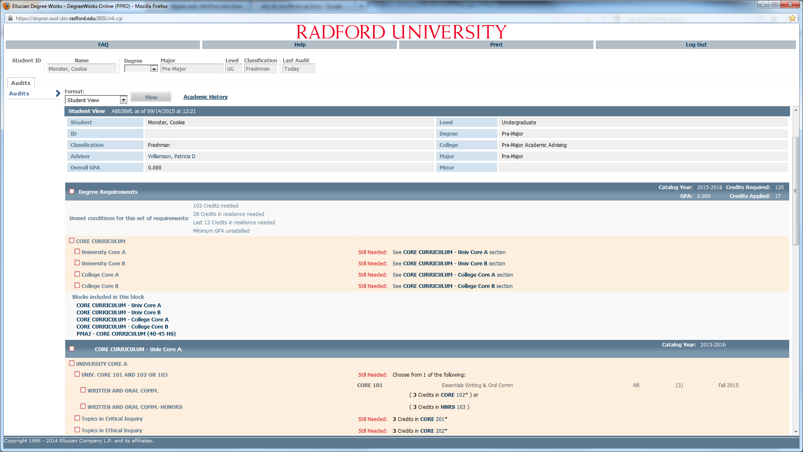
Undergraduate Academic Advising
Notes:
Your degree audit will have important information:
It will have your college, major and advisor listed at the top.
Click on your advisor to email.
It should have any Advanced placement, International baccalaureate, and/or Dual Enrollment credits listed. Make sure you get these sent to the admissions office if not showing!
It will show (squiggles) what you are taking, (check marks) for what you have taken or transferred in (AP, IB, DE credit) and empty red blocks for what you still need in the Core Curriculum and your major requirements.
Remember you have until you graduate to take all of your core curriculum classes
Your current enrollment will be at the bottom of the audit
If you have declared your major it will have all of the classes required for the major

Slide 16
HOW DO I MAKE AN ADVISING APPOINTMENT?
Now that you know your advisor’s name from your Degree Audit, you can look up your advisor on the appointment scheduler, AgileAdvisor.
If you do not find your advisor listed on AgileAdvisor, go to your Degree Audit to email him/her to ask how to make an appointment. If your advisor is not listed please contact your advising center listed on the Undergraduate Academic Advising website www.radford.edu/advising.
Undergraduate Academic Advising

Slide 17
AGILEADVISOR APPOINTMENT SCHEDULER
Undergraduate Academic Advising
Notes:
To make an appointment on Agile Advisor for academic or career advising , go to your academic tools, academic advising appointment.

Slide 18
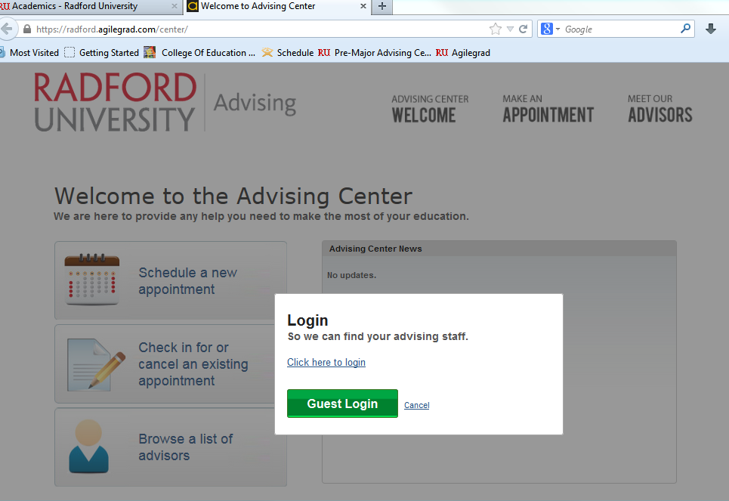
Undergraduate Academic Advising
Notes:
Go to the Login, NOT the Guest login. If you need to login, you will use your RU login and password.

Slide 19
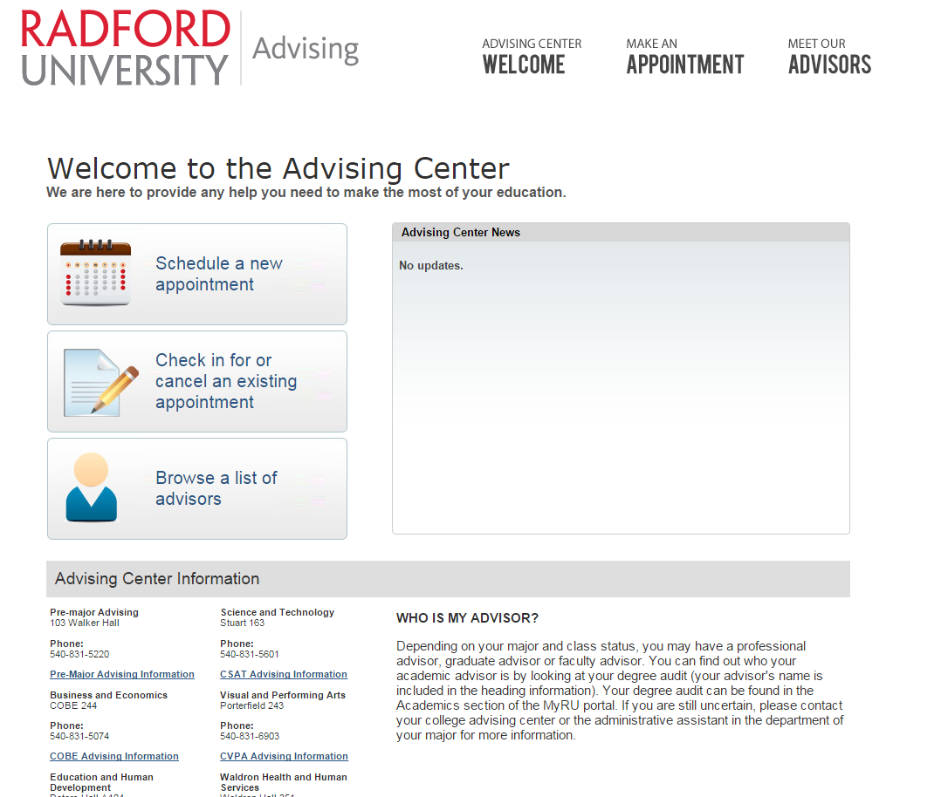
Undergraduate Academic Advising
Notes:
Currently the advisors located in the advising centers and in the career center are using Agile Advisor to schedule student appointments. If your advisor does not have a profile on the list of advisors, or is not listed, just email him/her to find out how to make an appointment.
If you need assistance with how to use the Agile Advisor scheduling system just go to the Undergraduate Academic Advising website.

Slide 20
FERPA
FAMILY EDUCATIONAL RIGHTS and PRIVACY ACT
The university will not release information about a student from records, except directory information, to people (including parents) other than a specified list of exceptions without obtaining the written consent of the student by having the student complete a FERPA form, available online and in the Registrar’s office.
http://www.radford.edu/~registra/FERPA_Release_Form.pdf
http://www.radford.edu/content/registrar/home/about/ferpa-policy.html
Undergraduate Academic Advising
Notes:
In order for your advisor or instructors to speak with your parents you would need to sign a FERPA release form which can be located on the Registrar’s website.

Slide 21
IMPORTANT POLICIES YOU NEED TO KNOW
COURSE WITHDRAWAL INFORMATION FOR FALL SEMESTER
You receive a “W” on your transcript.
You are allowed only 5 withdrawals the entire time at RU
The withdrawal period begins when schedule adjustment week ends until
October 16th for UNIV100.
October 23rd for 3 or more credit hour courses.
See Academic Calendar for withdrawal deadlines for other semesters
WHAT IF I GO BELOW FULL-TIME (12 hours?)
You will NOT need to move out of your residence hall unless your behavior is disruptive. You WILL need to notify your Resident Assistant if you fall below full-time status.
Dropping from full to part-time status during a semester may affect your financial aid. Check with the Office of Financial Aid.
If you are a student athlete or international student please check with your advisor and financial aid before going below full-time.
Undergraduate Academic Advising
Notes:
Some important academic policies for you to know and understand. You can refer back to these policies on the Undergraduate Academic Advising Website.

Slide 22
IMPORTANT POLICIES YOU NEED TO KNOW
REPEATING A COURSE
The grade earned in the repeated course will replace the original grade in GPA calculations; however the original grade will remain on your transcript.
You are allowed to repeat only 3 courses
Always check with your advisor to see how the repeat policy would effect you
After you have used your 3 repeats you are allowed an unlimited number of retakes.
both grades are used in the cumulative GPA calculation as if they are two separate classes (retakes count the same as taking new classes)
Undergraduate Academic Advising
Notes:
Some important academic policies for you to know and understand. You can refer back to these policies on the Undergraduate Academic Advising Website.

Slide 23
HOW MANY CREDITS DO I NEED TO GRADUATE?
The minimum number of credit hours needed to graduate in most programs is 120 hours; however some majors require more than 120.
Specific requirements for each major can be found in the catalog.
120 hours/8 semesters is 15 hours a semester to stay on track without taking summer school courses.
Undergraduate Academic Advising

Slide 24
TYPICAL COURSELOAD
Full-time Minimum | 12 Hours
Full-time Maximum | 18 Hours
Typical Class Load | 14-17 Hours
Undergraduate Academic Advising
Notes:
A student on academic probation can not carry more than 16 semester hours during fall and/or spring semesters.
Students pay additional tuition for hours over 18.

Slide 25
IMPORTANCE OF A GOOD GRADE POINT AVERAGE (GPA)
Some majors do not require a specific GPA, others can require as high as a 3.5.
To take “upper division” courses in your major.
Most majors will accept you into the major with any GPA; however, some have GPA and course prerequisites to begin junior level courses.
To graduate from RU
You will need a minimum of a 2.0; however some majors require higher GPAs to graduate; For example nursing requires a 2.5 and elementary education requires a 3.0.
To avoid Probation and Suspension
Undergraduate Academic Advising
Notes:
Most majors require a minimum cumulative GPA of a 2.0 but some require a higher GPA. This is one of the many reasons why you should make your academics a priority. You don’t want to hit a roadblock to declaring a major or graduating. In addition many majors have specific GPA requirements in the major for graduation. Specific requirements for each major are listed in the catalog and are listed on most Progress Sheets.

Slide 26
PROBATION AND SUSPENSION
Academic Probation occurs any semester your cumulative GPA is below a 2.0 but above the suspension threshold (listed below).
New Student Suspension Policy Any new (freshman or transfer), full-time (as of the census date) student who has a GPA below 1.00 at the conclusion of the first semester of enrollment will be suspended. The student will not be allowed to continue in the next wintermester or spring semester (if the student first enrolled in the fall) or summer sessions and fall semester (if the student first enrolled in the spring).
Continuing student Suspension Policy
Hours Attempted at RU only | GPA Required to Avoid Suspension at the end of each semester
13-23 | 1.00
24-35 | 1.50
36-47 | 1.80
48 or more | 2.00
Undergraduate Academic Advising
Notes:
There are NO exceptions to Suspension

Slide 27
DEANS LIST
Dean’s List recognition requires all of the following:
A semester GPA of at least 3.40 in a minimum of 12 hours of graded courses with no course grade of less than C and no “Incomplete” grades.
Undergraduate Academic Advising

Slide 28
CLASS STANDING
Hours Passed | Status
<26 | Freshman
26-55 | Sophomore
56-85 | Junior
> 86 | Senior
Undergraduate Academic Advising
Notes:
Includes Advanced Credit, International baccalaureate, Dual Enrollment and Transfer courses

Slide 29
Undergraduate Academic Advising
Notes:
Pre-majors are required to attend and everyone else SHOULD attend the Majors and Minors Fair on Oct. 13th from 1 – 3, in Heth Hall. ALL of the majors and minors at RU, as well as other programs such as Study Abroad will be there for you to talk to. You can even declare or change your major at the fair. Plus they usually have great apple cider!

Slide 30
Attending Summer School or Wintermester
Radford offers 5 summer sessions: Maymester (3 weeks), Summer I, Summer II (5 weeks each), Summer III, ( 11 weeks), and Augustmester (3 weeks and online).
Wintermester is a 3 week on-line semester during winter break.
Courses from community colleges
Grades will not transfer only credit hours
Undergraduate Academic Advising
Notes:
Many of Radford’s summer school classes and all of the wintermester courses are online.
Housing is available on campus for summer school

Slide 31
Undergraduate Academic Advising
Notes:
Success depends on YOU being YOUR own best advocate
You are now in the driver’s seat.
Get started this fall on the right foot

