Slide 1
DEI Training Quiz
A quick refresher on what we covered

Slide 2
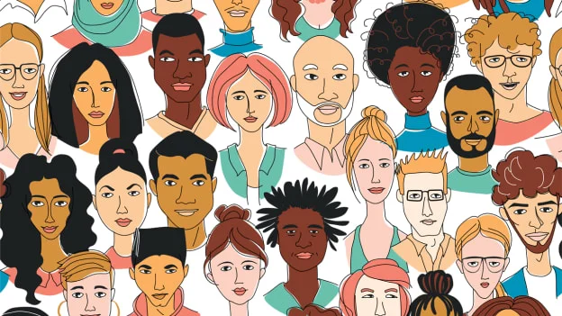
True OR False?
People are always aware of their biases.

Slide 3
FALSE!
Implicit biases are biases people have that they are not aware of.

Slide 4
True or False?
Biases can influence behavior and thought patterns.

Slide 5
TRUE!
Being aware of these potential effects of biases is important and can help you combat them.

Slide 6
True or False?
Making decisions quickly is a way to combat biases.

Slide 7
False!
Taking time to reflect can prevent you from using shortcuts to make decisions about people and situations.

Slide 8
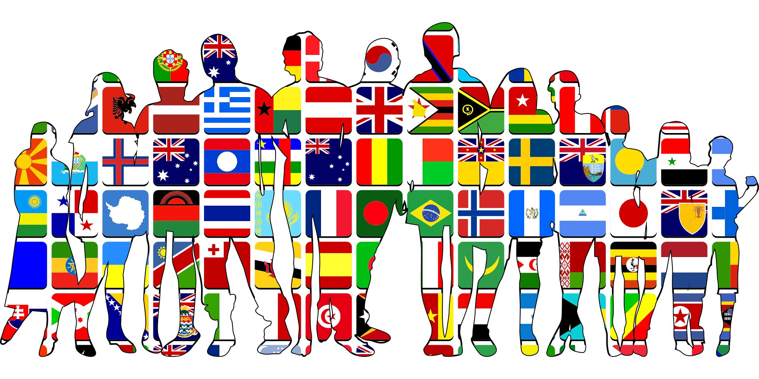
True or False?
Biases can change the way that employees perceive the workplace.

Slide 9
TRUE!
Combating biases at the organizational level can help create a more welcoming environment for employees.

Slide 10
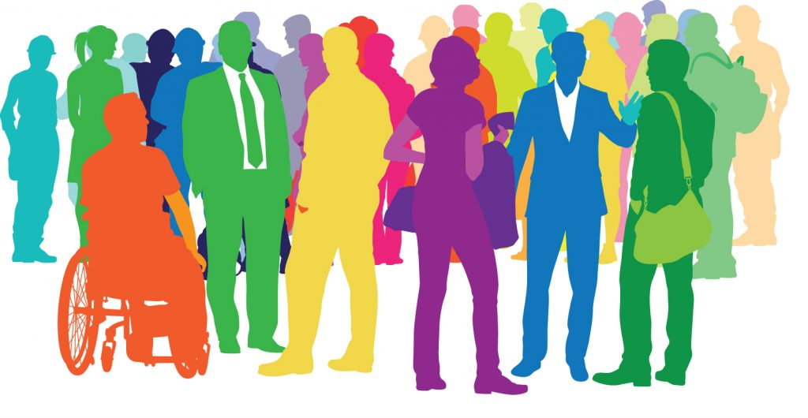
True or False?
Biases are bad, but generally harmless at the organizational level.

Slide 11
False!
Biases can lead to discriminatory processes that can cause long-term harm to an organization.

