Slide 1
DEI Training Quiz
A quick refresher on what we covered
Radford I/O Psychology

Slide 2
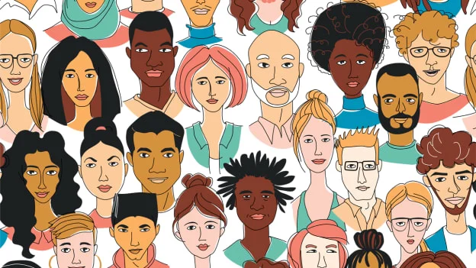
True OR False?
Diversity and Inclusion are the same thing.

Slide 3
FALSE!
Diversity and Inclusion are two different concepts but they work in tandem to help an organization.
Diversity - Observable and unobservable characteristics among members of a group.
Inclusion - How an employee perceives that they are welcome in the workplace through experiences that satisfy their needs, and the assurance that their voice is important and heard.

Slide 4
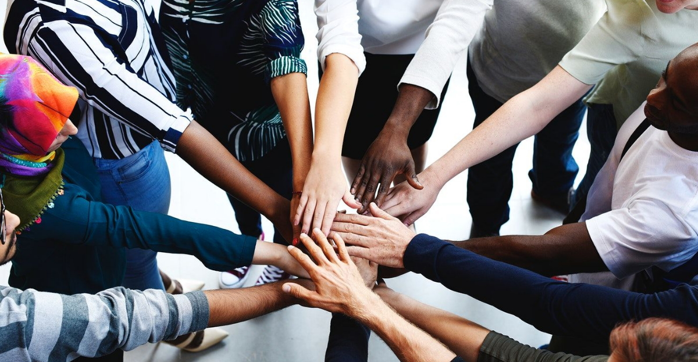
True or False?
When done correctly, DEI training will eliminate discrimination.

Slide 5
FALSE!
DEI training may not completely eliminate discrimination, but should help reduce it and other damaging behaviors.

Slide 6
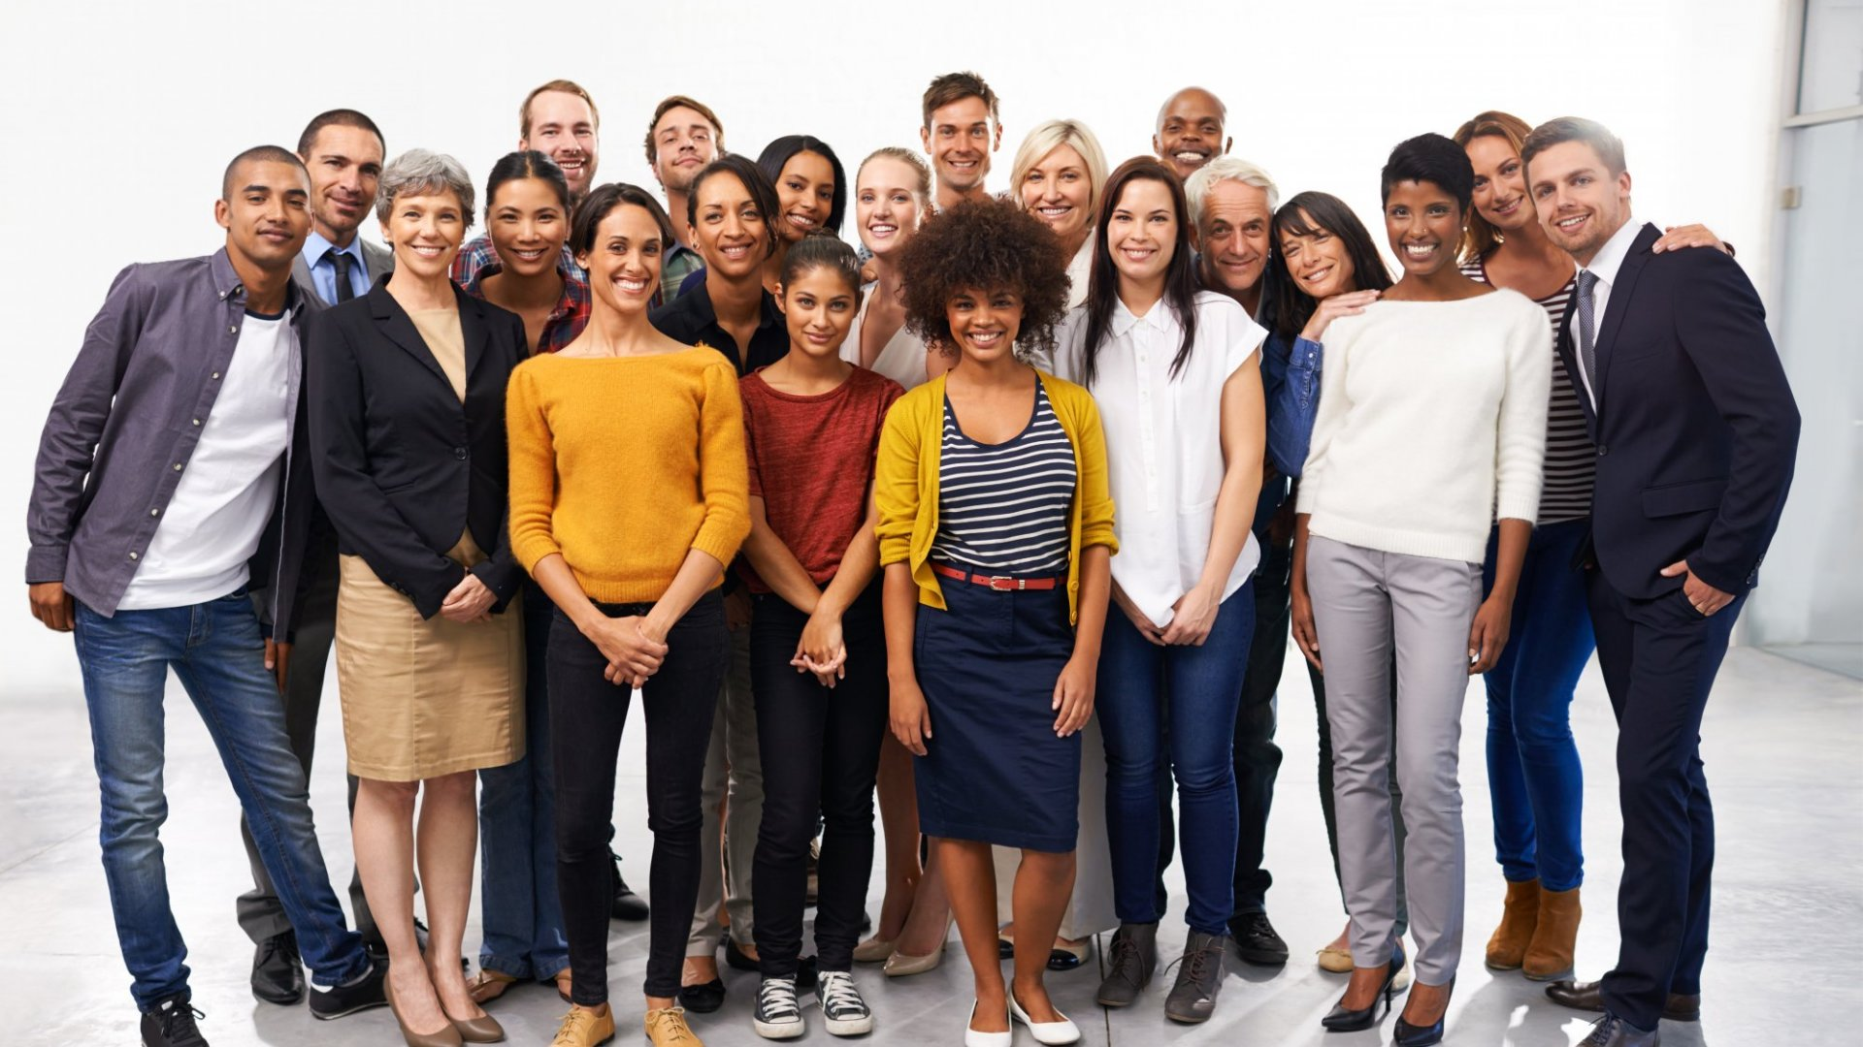
True or False?
DEI Training should involve organizational leaders.

Slide 7
TRUE!
Getting organizational leaders involved in DEI training encourages accountability and shows that the organization is serious about DEI.

Slide 8
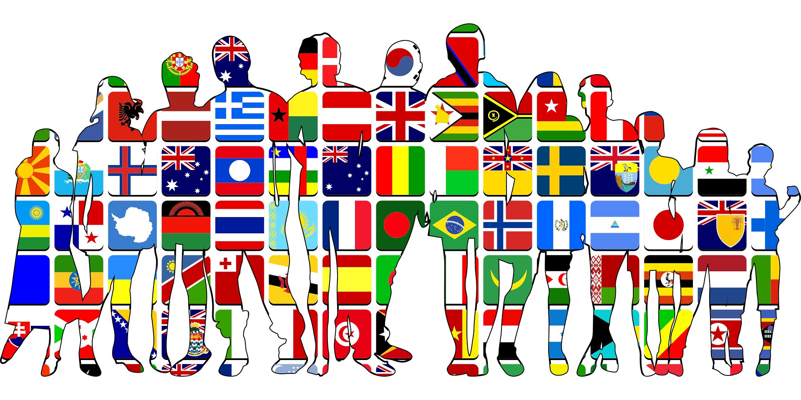
True or False?
Equity and Equality are the same thing.

Slide 9
FALSE!
Equality is giving everyone the same thing, Equity is giving them what they need.

Slide 10
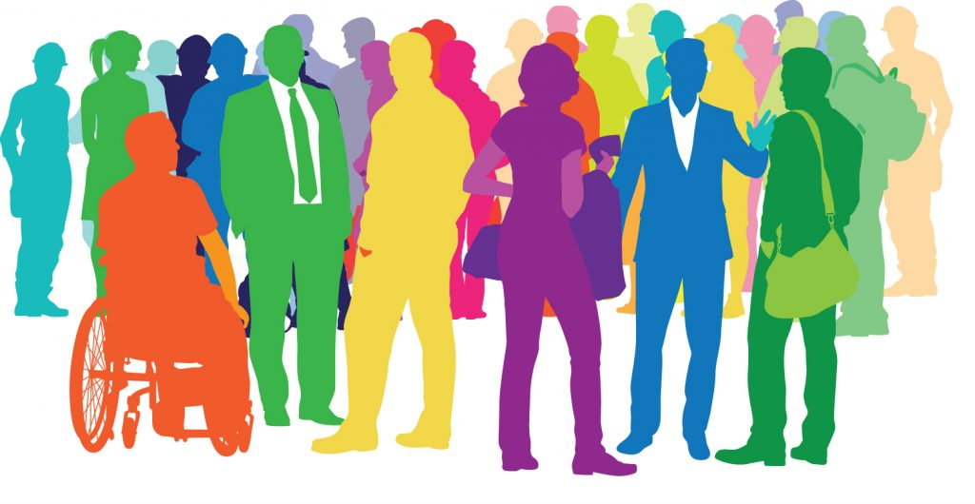
True or False?
DEI Training focuses on race and gender, invisible traits aren’t covered.

Slide 11
False!
Quality DEI training programs should include materials on invisible traits.

