Slide 1
Module 1
DEI Training
Radford I/O Psychology

Slide 2
Overview
Introduction
Definitions
Myths
Goals
DEI

Slide 3
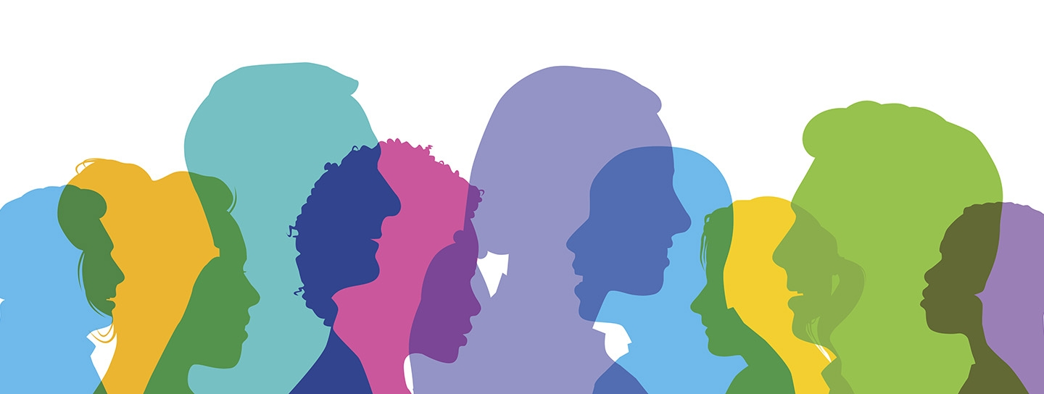
What is DEI training?
Diversity, Equity, and Inclusion training builds a foundation of knowledge and understanding of diverse people in the workplace.
It promotes positive intergroup interactions and reduces prejudice and biases.
DEI

Slide 4
Why DEI training?
Benefits the organization and individuals
Increased financial returns and innovation
Fosters a fair and equal work environment in which everyone gets treated with respect
Better teamwork
Increases employee moral
Motivates positive behaviors and attitudes
DEI

Slide 5
Common DEI terms
Diversity
Observable and unobservable characteristics among members of a group.
Equity
Ensures that individuals are provided the resources they need to have access to the same opportunities, as the general population.
Terms

Slide 6
Common DEI terms
Inclusion
To what extent an employee perceives that they are welcome in the workplace through experiences that satisfy their needs, and the assurance that their voice is important and heard.
Bias
An inclination or preference, especially one that interferes with impartial judgement.
Terms

Slide 7
Common DEI terms
Prejudice
A prejudgment, usually negative, attitude of one type of individual or groups towards another group and its members.
Stereotype
Over-generalized belief about a particular category of people.
Terms

Slide 8
Common DEI terms
Worldview
The perspective through which individuals view the world; comprised of their history, experiences, culture, family history, and other influences.
Ally
Someone who actively supports people who belong in other groups than the one they belong to and acknowledges their inherent struggles.
Terms

Slide 9
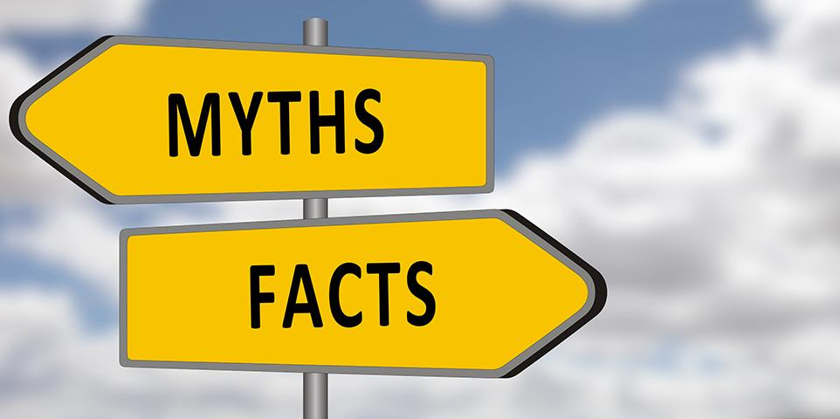
Common DEI myths
Here are some common DEI myths:
Diversity programs are only good for being “politically correct”.
Promoting diversity doesn’t prevent discrimination.
Diversity training is unnecessary.
Diversity is just about race and gender.
The concept of diversity excludes white men.
Myths
Notes:
Have you heard of any other myths?
Why do you think these myths exist?

Slide 10
Common DEI myths
Diversity programs are only good for being ”politically correct”.
This is usually based on the assumption that diversity training only cares about meeting a “quota” and fulfilling a legal or HR requirement. In reality, DEI training is about fostering equal representation.
Myths
Notes:
*Population data demonstrates that the general North American populace will be without a known majority in terms of race, nationality, and sexuality by the year 2065.
*https://www.pewresearch.org/fact-tank/2015/10/05/future-immigration-will-change-the-face-of-america-by-2065/

Slide 11
Common DEI myths
Promoting diversity doesn’t prevent discrimination.
While it may not completely prevent discrimination, it certainly helps. A diverse workplace helps to actively discourage behaviors that could end up harming the company and employees.
Myths
Notes:
https://www.eeoc.gov/select-task-force-study-harassment-workplace?renderforprint=1

Slide 12
Common DEI myths
Diversity training is unnecessary.
Most organizations with this mindset feel that they already have a diverse workplace that doesn’t have any issues. The reality is that even if 1 of the 3 main goals are met (Diversity, Equity or Inclusion), chances are that the other two still need work.
Myths

Slide 13
Common DEI myths
The concept of diversity excludes white men.
Among white males there is a large amount of unobservable diversity. Successful DEI programs focus on these differences, encourage inclusion for all diversity groups, and include materials about traits beyond race and gender.
Myths
Notes:
Diversity training is meant to benefit everyone.
*http://www.whitemensleadershipstudy.com/pdf/WMLS%20Executive%20Summary.pdf

Slide 14
Common DEI myths
Diversity is just about gender and race.
Diversity encompasses a wide variety of traits, both visible and invisible: age, disability, gender identity, sexual orientation, personality, thinking style, leadership style, and others are all focal points in a successful DEI training program.
Myths
Notes:
Although the thought of diversity often elicits the thought of gender and race, diversity can take on many forms.
Surface-level characteristics: gender, race, age
Deep-level characteristics (undetectable at the superficial level): attitudes, values, sexual orientation, education level, religious beliefs, physical abilities, socioeconomic background

Slide 15
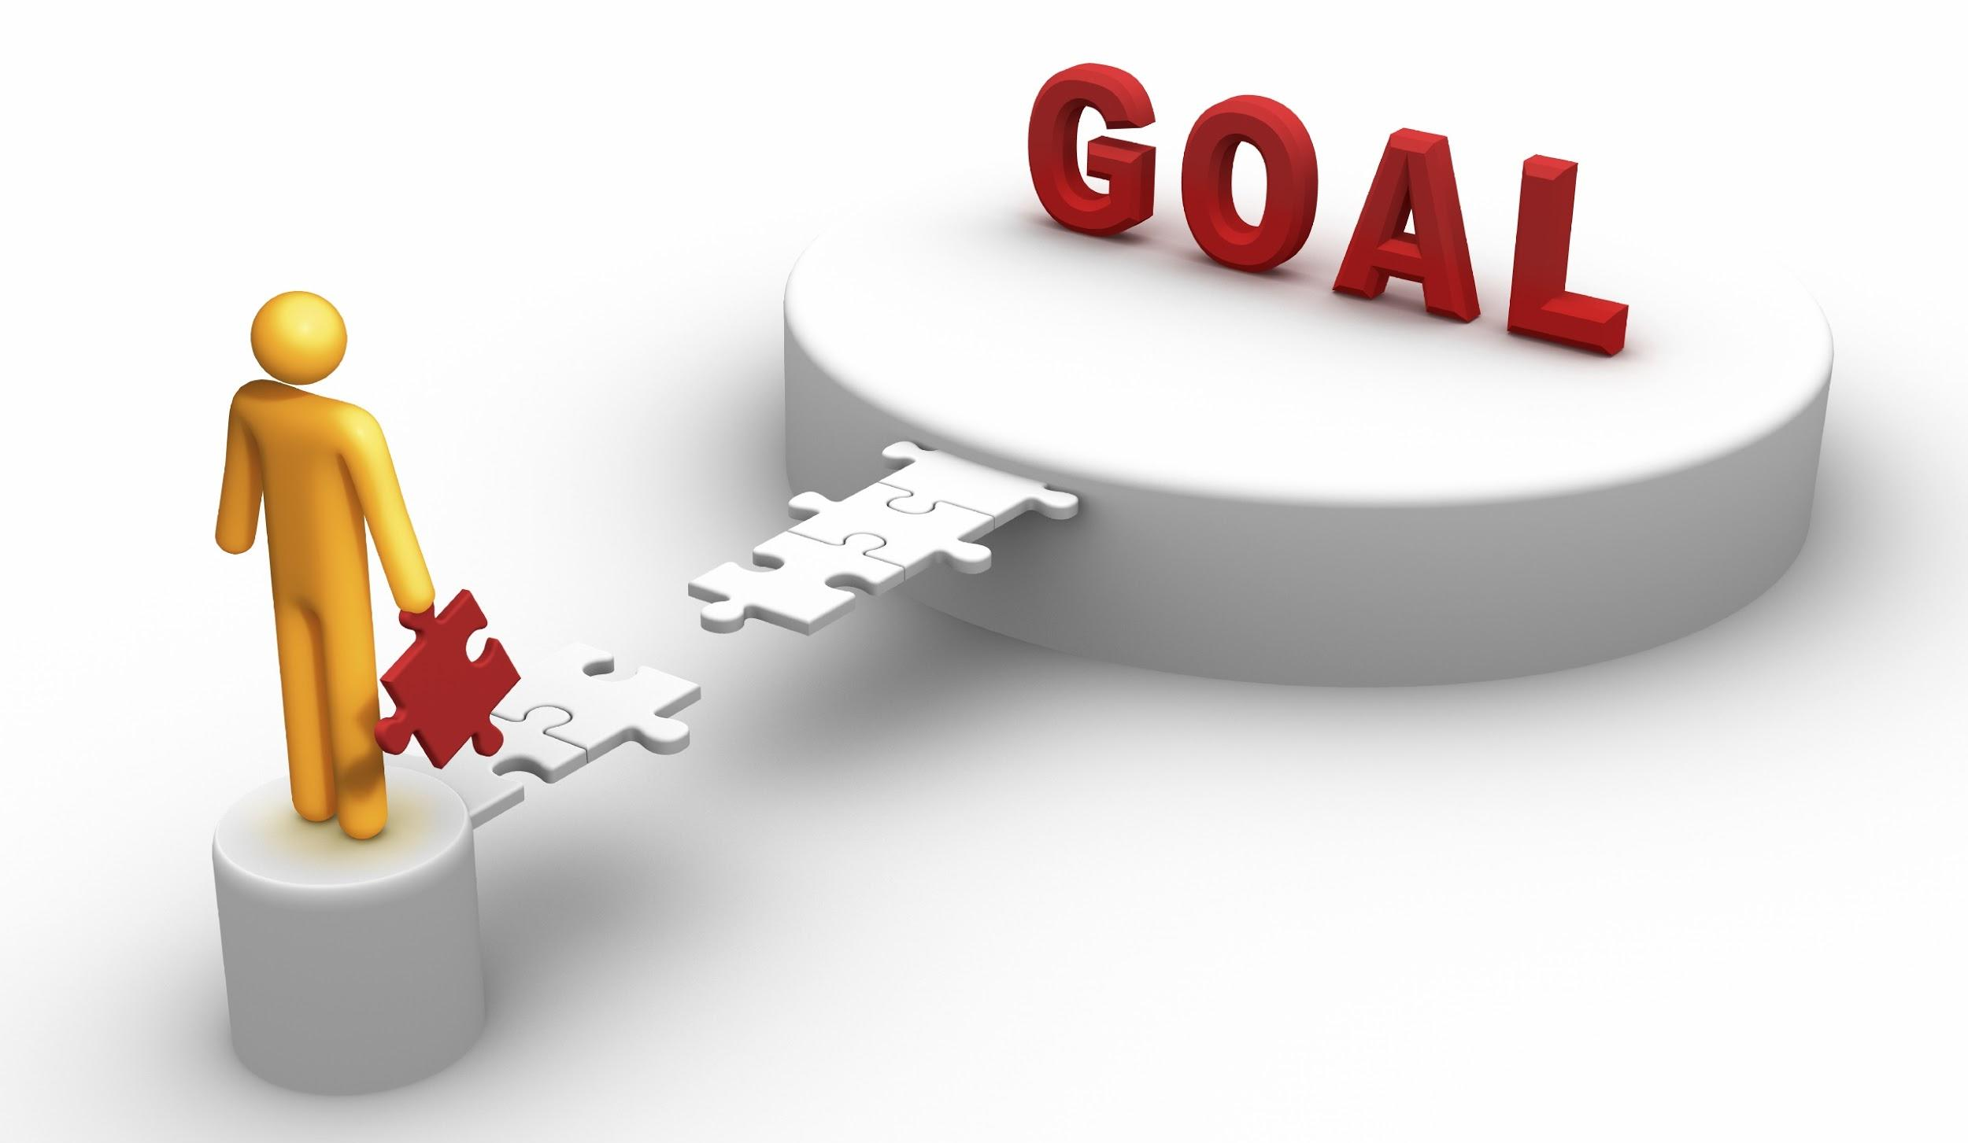
What are some goals of DEI training?
Promote the benefits of DEI and frame DEI as an organizational advantage, not just a chore
Educate, inspire, and support employees while promoting conversation
Enhance and encourage accountability by involving leaders
Foster additional training and support materials that promote a culture of diversity, equity and inclusion
Goals

Slide 16
Conclusion
DEI training can provide useful tools, skills, and knowledge to unlock a better understanding of what people can bring to the workforce.
DEI training can reveal unconscious biases and provide measures to combat them.
DEI training can reduce negativity within the organization and enhance organizational culture.
Notes:
*Population data demonstrates that the general North American populace will be without a known majority in terms of race, nationality, and sexuality by the year 2065.
*https://www.pewresearch.org/fact-tank/2015/10/05/future-immigration-will-change-the-face-of-america-by-2065/

