Slide 1
Radford Friday Meeting Presentation
Paul Bresnan

Slide 2
- 2013 - 2015
- 2015 - 2016
- 2016 - 2018
- 2018 - Present
Notes:
5 years of HRIT experience. Living in DC area.
Clients are large federal organizations implementing HR software
First 2 employers were vendors
Econsys – team of researchers, statisticans, economists. I did engagement surveys & competency assessments.
FMP, I moved over to the other side of the table, becoming a client advocate.
FMP does many types of HR consulting projects. I’ve done Employee Selection, Employee Engagement surveys, workforce development modernization and benchmarking study
Technology and Transformation has been the biggest growth area for FMP

Slide 3
Human Resources (I/O)
Paul
Federal Contracting
IT Lifecycle
Notes:
Professional Competencies. Radford equipped me with HR knowledge. But I had a steep learning curve for managing IT tools and Federal contracting. Today I’d like to spend more time talking about IT bubble.
Professional life is becoming increasingly more digitized. Heard someone describe the forced work remote challenge as organizations squeezing 3 years IT innovation and implementation into 3 months. It’s largely been successful. Even older government managers, who did not believe in working remote are realizing its benefits. Personally, I don’t think we’re going back. If everything opened tomorrow, I would not look forward to 1 hour commute on metro. Probably a mixed model of working if needed.
At some point in your career, I’d imagine you’d be interfacing with some sort of IT tool. Maybe asked to partner with IT developers to develop a competency assessment tool in-house, or review a vendor’s offering, or work HR in an IT company ( <- BIG opportunity going forward). Being able to talk in their language will have many advantages.

Slide 4
Agile
“The ability to create and respond to change. A way of dealing with and succeeding in uncertain environments.”
Framework software development teams are organized around
Appropriate when developing a novel solution and/or when vision is undefined
Can be applied to non-IT projects as well

Slide 5
Project Management vs Agile
Project Management (Waterfall)
Agile
Gather Requirements
Design
Implement
Test
Maintain
Gather Requirements
Design
Implement
Test
Maintain
Notes:
Waterfall is great when you have very clear requirements, scope is defined, and little “unknown unknowns?”
Pros:
Great for stable environments. Allows for accurate forecasting and budgeting. Can track and push to meet against deadlines. Great for stable environments.
Cons:
Less flexible. Hard to re-negotiate price. Risk that executive champion can move and get a new champion with a different vision. Get everything at the end. Risk of scope creep.
Eg, if your organization has done job analyses for 50 occupations, is happy with the process, and asks you to do it for a 51st occupation, This is appropriate for traditional project management.
Agile
Pros: Great when detailed requirements are unknown or subject to change. Doesn't reduce risks, but slices it up into small chunks and delivers over time. Gives ability to course correct. Early return on investment.
Cons: Uncertainty of scope and schedule makes stakeholders nervous. Especially executives and contracting officers. Need to manage backlog. Difficult to scale across many teams.

Slide 6
Scrum
A framework for Teams to apply Agile
Sprint – Timebox which team produces a shippable product
Backlog – List of all possible product items. Options, not commitments.
Planning – Team discussion on what to accomplish in a Sprint
Daily Scrum – Short daily team meeting to coordinate their activities for that day
Review – Review items completed at end of Sprint
Retro – Reflect on how Sprint went and identify adjustments

Slide 7
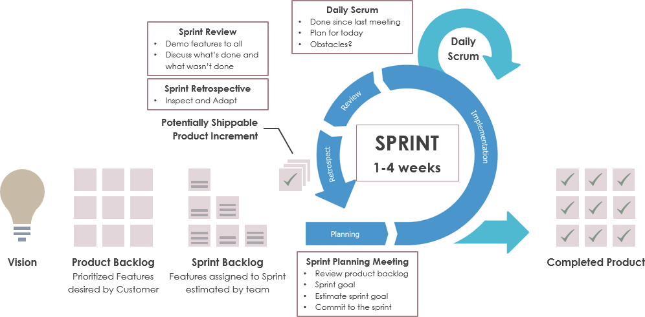

Slide 8
Notes:
Prioritization – Business Value, Cust Satisfaction, Risk, Cost & Time, Learning,
Features could be: Enhancements, Bugs, Research, Refactor (technical rewrite to make code more robust and adjustable)

Slide 9
Scrum Team
Product Owner
Development Team
Scrum Master
Notes:
Product Owner. – Manages Product Backlog. Brings knowledge of the market and client needs to the team. Determines the team’s direction when there are conflicting directions or no direction at all. Real life example - You have 1 customer that provides 80% of revenue. Want to diversify client base. Client is pushing hard for feature A. If you can’t provide it in a month, you risk losing the customer. A potential client is invites you to give a demo. You know the potential client wants Feature B, which will take a month to develop. Product’s job is to navigate this.
Development Team – Determines how the work gets done, and how long it will take. Often done throw a pointing system. Dev is usually highly specialized and compensated. They are self-organized and shielded from outside distractions. In an IT environment, their job is write beautiful code. EG. CEO asked me to get ready to Live Demo our competency assessment tool to a client…only we did not have a tool to demo. I partnered with a development team. My job was to translate how rating and UI system should perform into requirements they can understand. My job was NOT to tell them how to organize the data base, how much time they had to write code. They give an honest assessment on how much time they need for each requirement and I determined the priority and adjustments.
Scrum Master – Ensures the process is Agile and is being followed. Servant leader, often does not have actual authority. Coaches others, facilitates meeting, removes roadblocks, etc. Often time, their job is to shield management (eg executive is pressuring Dev team to speed up timelines, re-priortizies Product Owners’ backlog.
Real life example – HR in a fortune 500 company rolled out forced ranking Perf Management System. A rockstar division leader wrote back, saying his division will not be doing that. Was prepared to be fired. HR backed down, division was exempt. The people in his division were very thankful. If he were to be fired, he’d find another job, and many people would’ve followed him. Another division leader tried the same thing, he was let go.

Slide 10
Summary
How IT teams organize in uncertain environments
Project Management vs Agile
Scrum – An Agile Framework
https://www.agilealliance.org
pbresnan94@gmail.com
Notes:
Internships + Analyst + C1 Jobs.

