Slide 1
Careers in Psychometrics/Certification
Andrew T. Jones, Ph.D
Director of Psychometrics and Research
American Board of Surgery

Slide 2
Background
Educational background
B.S. Psychology Major (JMU – 2002)
M.A. I/O Psychology (Radford – 2004)
Ph.D Assessment and Measurement (JMU – 2009)
Career Background
Danaher (2004-2006)
American Board of Surgery (2009-2014;2015-Current)
Psychometrics/Research
American Board of Internal Medicine (2014-2015)

Slide 3
Psychometrics
Science of assessment
Psychometricians are primarily concerned with reliability and validity in the measurement of latent constructs/attributes
Use assessments as measurement instruments for a given attribute (knowledge, personality, skills)
Each item on an assessment is a small sample of the overall domain of knowledge for that construct
Goal is to collect enough samples (items) from the overall domain to infer ‘how much’ of an attribute examinees possess

Slide 4
Where do psychometricians work?
K-12
Higher ed
Corporate
Certification/Licensure

Slide 5
K-12
Accountability
SATs
AP Exams
Skills assessments

Slide 6
Higher Ed
Accreditation
Professional Education assessment
For profit higher ed institutions (e.g., Western Governor’s)

Slide 7
Corporate
More similar to traditional I/O jobs
Amazon
I/O consulting firms
Big Tech
Netflix challenge way back in 2009

Slide 8
Certification/Licensure
IT certification
Bar exams
Medical certification
Physicians
Nurses
Physician’s assistants

Slide 9
Certification/Licensure
Some of the highest stakes testing of any context
Organizations have mission of protecting the public
Examinees have invested a staggering amount of their life in profession and credentials are highly valuable
Licenses can be essential to practice
Critical that these exams be as fair/reliable/valid/defensible as possible for making high-stakes decisions

Slide 10
American Board of Surgery
Established in 1937
Founded to provide board certification to individuals who have met a defined standard of education, training, and knowledge in field of surgery
Process
Educational/assessment prerequisites
Pass qualifying exam (multiple-choice exam)
Pass certifying exam (oral exam)

Slide 11
American Board of Surgery
Qualifying exam
320 multiple-choice item exam
9 hours
Delivered in Pearson centers across country
Highly secure and standardized

Slide 12
Qualifying Exam
Standard setting
Gather SMEs
Review content on exam
Generate passing score

Slide 13
Qualifying Exam
Reliability analysis
Item analysis
Different forms in different years
Test assembly
Need to balance forms for similar psychometric characteristics
Have to equate the exams across administrations to adjust standards from year to year
Validity
Work with SMEs to build content that represents what a certified surgeon should know

Slide 14
Certifying Exam
C4
C4
C4
C4
C4
C4
C3
C3
C3
C3
C3
C3
C2
C2
C2
C2
C2
C2
C1
C1
C1
C1
C1
C1
R1
R2
R3
R4
R5
R6
Room 1
Room 2
Room 3
Examinee

Slide 15
Scoring the Exam
As different candidates will be rated by different raters and have different sets of cases, we can view the raters and cases as different versions of the exam
How do we control for variation in examiner severity and tendencies?
Potential solutions
Rater training
Roster assembly
Team Assembly
Statistical corrections
Formative Feedback

Slide 16
Research
Psychometric research
Value of certification research
Medical assessment research

Slide 17
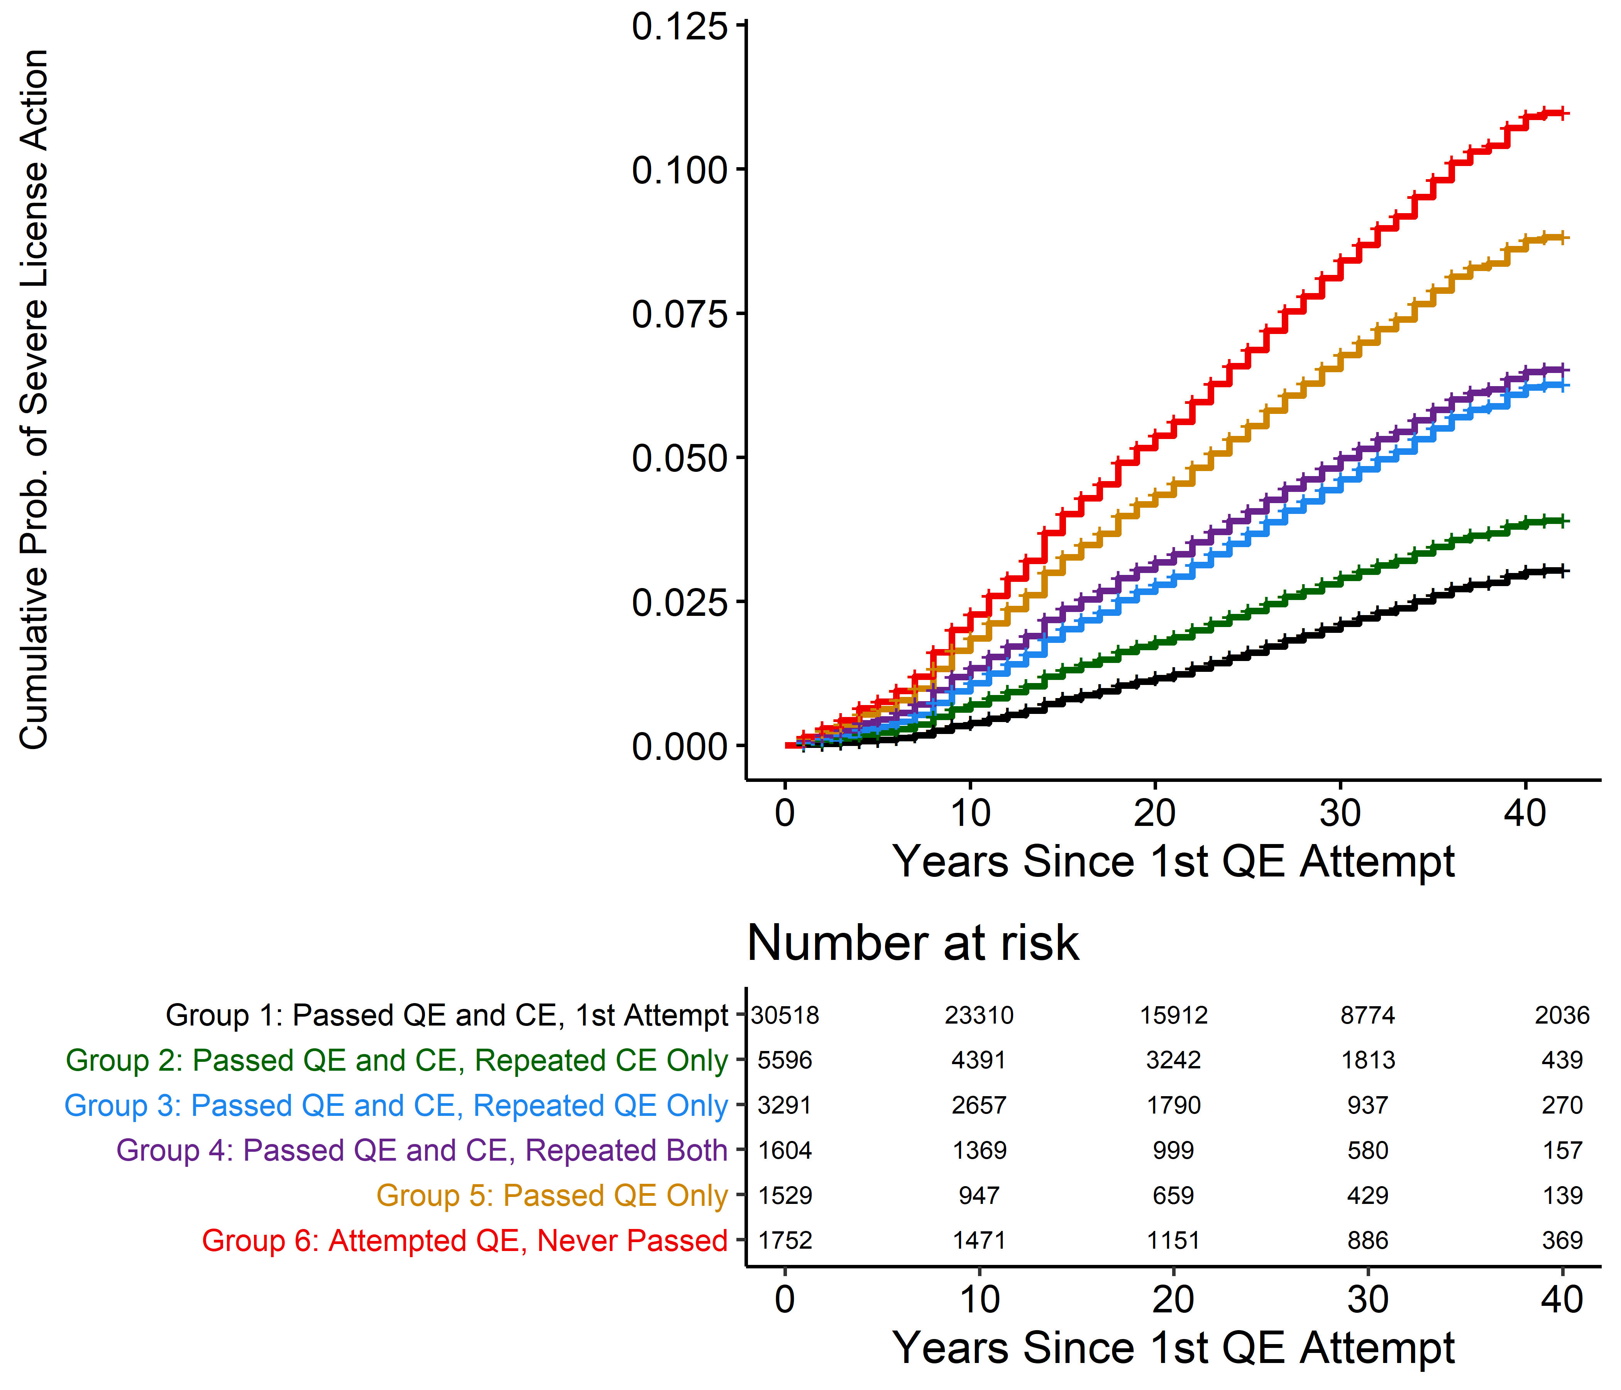
Research
Kopp JP, Ibáñez B, Jones AT, Pei X, Young A, Arnhart K, Rizzo AG, Buyske J. Association Between American Board of Surgery Initial Certification and Risk of Receiving Severe Disciplinary Actions Against Medical Licenses. JAMA Surg. 2020 May 1;155(5):e200093. doi: 10.1001/jamasurg.2020.0093. Epub 2020 May 20. PMID: 32186688; PMCID: PMC7081147.

Slide 18
New initiatives
Video-based assessments
Entrustable Professional Activities (EPAs)
Measuring patient outcomes

Slide 19
Other tasks
Survey design
Project management
COVID adaptations

Slide 20
Requisite skills/interests
Psychometrics
Must love stats/data
Statistical software (SPSS, SAS, R)
Communication/presentation skills
Scientific mindset
Non-psychometrics jobs in certification
Exam development
Project management
Applying principles of assessment
Working closely with SMEs to develop content
Detail-oriented
Assertive

Slide 21
Questions?
ajones@absurgery.org

